Slide 1
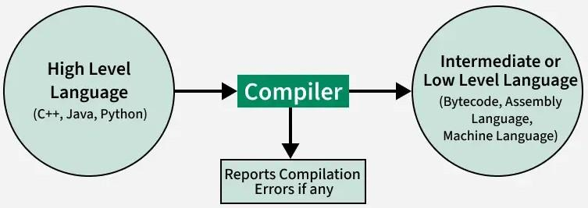
Compiler Design
History of Compilers
In the 1950s, Grace Hopper developed the first compiler, leading to languages like FORTRAN (1957), LISP (1958), and COBOL (1959). The 1960s saw innovations like ALGOL, and the 1970s introduced C and Pascal. Modern compilers focus on optimization, supporting object-oriented features and Just-in-Time compilation. Compilers have revolutionized programming, enabling complex systems and improving software efficiency.
Language Processing System
We have learnt that any computer system is made of hardware and software. The hardware understands a language, which humans cannot understand. So we write programs in high-level language, which is easier for us to understand and remember. These programs are then fed into a series of tools and OS components to get the desired code that can be used by the machine. This is known as Language Processing System.

Slide 2
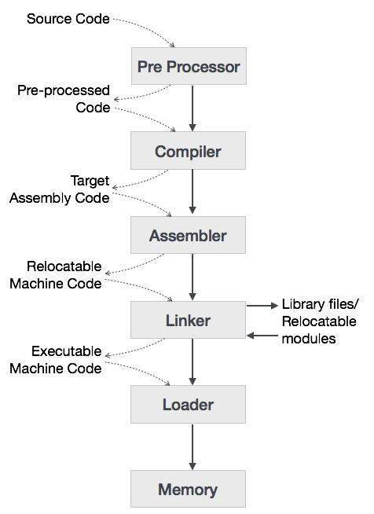
The high-level language is converted into binary language in various phases. A compiler is a program that converts high-level language to assembly language. Similarly, an assembler is a program that converts the assembly language to machine-level language.
Let us first understand how a program, using C compiler, is executed on a host machine.
User writes a program in C language (high-level language).
The C compiler, compiles the program and translates it to assembly program (low-level language).
An assembler then translates the assembly program into machine code (object).
A linker tool is used to link all the parts of the program together for execution (executable machine code).
A loader loads all of them into memory and then the program is executed.

Slide 3
Preprocessor
A preprocessor, generally considered as a part of compiler, is a tool that produces input for compilers. It deals with macro-processing, augmentation, file inclusion, language extension, etc.
Interpreter
An interpreter, like a compiler, translates high-level language into low-level machine language. The difference lies in the way they read the source code or input. A compiler reads the whole source code at once, creates tokens, checks semantics, generates intermediate code, executes the whole program and may involve many passes. In contrast, an interpreter reads a statement from the input, converts it to an intermediate code, executes it, then takes the next statement in sequence. If an error occurs, an interpreter stops execution and reports it. whereas a compiler reads the whole program even if it encounters several errors.
Assembler
An assembler translates assembly language programs into machine code.The output of an assembler is called an object file, which contains a combination of machine instructions as well as the data required to place these instructions in memory.

Slide 4
Linker
Linker is a computer program that links and merges various object files together in order to make an executable file. All these files might have been compiled by separate assemblers. The major task of a linker is to search and locate referenced module/routines in a program and to determine the memory location where these codes will be loaded, making the program instruction to have absolute references.
Loader
Loader is a part of operating system and is responsible for loading executable files into memory and execute them. It calculates the size of a program (instructions and data) and creates memory space for it. It initializes various registers to initiate execution.
Cross-compiler
A compiler that runs on platform (A) and is capable of generating executable code for platform (B) is called a cross-compiler.

Slide 5
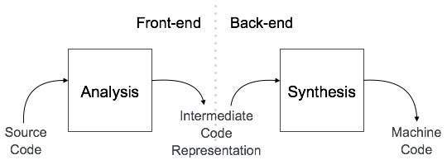
Compiler Architecture
A compiler can broadly be divided into two phases based on the way they compile.
Analysis Phase
Known as the front-end of the compiler, the analysis phase of the compiler reads the source program, divides it into core parts and then checks for lexical, grammar and syntax errors.The analysis phase generates an intermediate representation of the source program and symbol table, which should be fed to the Synthesis phase as input.
Synthesis Phase
Known as the back-end of the compiler, the synthesis phase generates the target program with the help of intermediate source code representation and symbol table.
A compiler can have many phases and passes.
Pass : A pass refers to the traversal of a compiler through the entire program.
Phase : A phase of a compiler is a distinguishable stage, which takes input from the previous stage, processes and yields output that can be used as input for the next stage. A pass can have more than one phase.

Slide 6
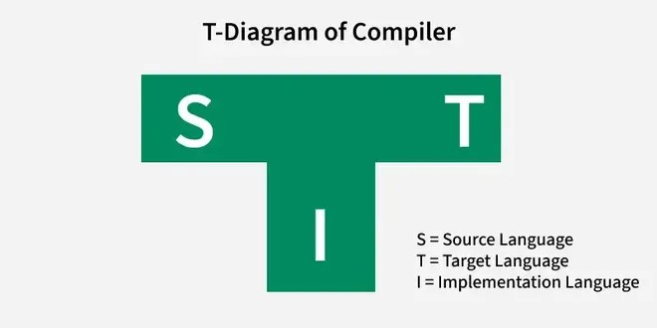
Bootstrapping in Compiler Design
Bootstrapping is an important technique in compiler design, where a basic compiler is used to create a more advanced version of itself. This process helps in building compilers for new programming languages and improving the ones already in use. By starting with a simple compiler, bootstrapping allows gradual improvements and makes the compiler more efficient over time.
Bootstrapping relies on the idea of a self-compiling compiler, where each iteration improves the compiler’s ability to handle more complex code.
It simplifies the development cycle, allowing incremental improvements and faster deployment of more robust compilers.
Many successful programming languages, including C and Java, have used bootstrapping techniques during their development.

Slide 7
A compiler can be represented using a T Diagram. In this diagram, the source language of the compiler is positioned at the top-left, the target language (the language produced by the compiler) is placed at the top-right, and the language in which the compiler is implemented is shown at the bottom.
Working of Bootstrapping
Bootstrapping is the process of creating compilers. It involves a methodology where a slightly more complicated compiler is created using a simple language (such as assembly language). This slightly more complicated compiler, in turn, is used to create an even more advanced compiler, and this process continues until the desired result is achieved.
Here’s a step-by-step look at how bootstrapping works in compiler design:
Step 1: Start with a Basic Compiler
The first step is to create a basic compiler that can handle the most essential features of a programming language. This simple compiler is often written in assembly language or machine language to make it easier to build.
Step 2: Use the Basic Compiler to Create a More Advanced Version
Once the basic compiler is ready, it is used to compile a more advanced version of itself. This new version can handle more complex features, like better error checking and optimizations.
Step 3: Gradually Improve the Compiler
With each new version, the compiler becomes more capable. The process is repeated, and each iteration adds more features, making the compiler stronger and more efficient.

Slide 8


For example, let’s assume a compiler which takes C language as input and generates an assembly language as an output.
To generate this compiler we first write a compiler for a small subset of C language i.e. C0 in assembly language. Subset of C means C language with less functionality.
Here in the T diagram, source language is subset of C (C0), target language is Assembly language and implementation language is also Assembly language.
2. Then using the C0 language, we create a compiler for the C language. This compiler C0, takes C language as source language and generates assembly language as target language as shown below.

Slide 9
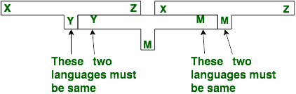
Cross-Compilation Using Bootstrapping
Cross-compilation is a process where a compiler runs on one platform (host) but generates machine code for a different platform (target). This is useful when the target platform is not powerful enough to run the full compiler or when the target architecture is different from the host system. Using bootstrapping in cross-compilation can help create a compiler that runs on one system (the host) but produces code for another system (the target).
For example, suppose we want to write a cross compiler for new language X. To create a cross-compiler for a new language X that generates code in language Z, we start by using an existing compiler Y (running on machine M) to compile a simple version of language X into language Z. The first step is to create a basic compiler, XYZ, using Y that translates X code into Z code, all while running on machine M. This results in a cross-compiler XMZ, which is capable of generating target code in language Z for the source code in language X, but it runs on machine M. This method allows us to create a compiler for a new language without needing to run it on the target system directly.

Slide 10
Advantages
Improved Efficiency: Bootstrapping makes the development process faster. Once you have a basic compiler, you can use it to create more advanced versions, making the entire process of building a complex compiler much quicker. It’s like building a tool that helps you build better versions of itself.
Portability: Bootstrapping helps create compilers that can work across different systems. Once you’ve bootstrapped a compiler, it can be used to generate code for various platforms, making it more flexible and portable.
Reduced Dependency: With bootstrapping, you don’t need to rely on other compilers or external tools. As long as you have a simple starting compiler, you can use it to build more complex versions and handle all your compiling needs. This reduces the need for other software or external dependencies.
Challenges and Limitations
Initial Effort: Writing the very first version of the compiler is tough. Before bootstrapping can even begin, you need to create a simple, working compiler from scratch, which requires a lot of time and effort.
Complexity of Self-Compilation: A compiler that can compile itself sounds great, but it’s not easy to make. Building a self-compiling compiler adds complexity because you have to ensure that each version can handle more features and still work as expected.
Time Consumption: Bootstrapping is not something that happens overnight. It takes time and resources, especially during the early stages. You have to repeatedly build and improve versions of the compiler, which can be a slow process in the beginning.

Slide 11
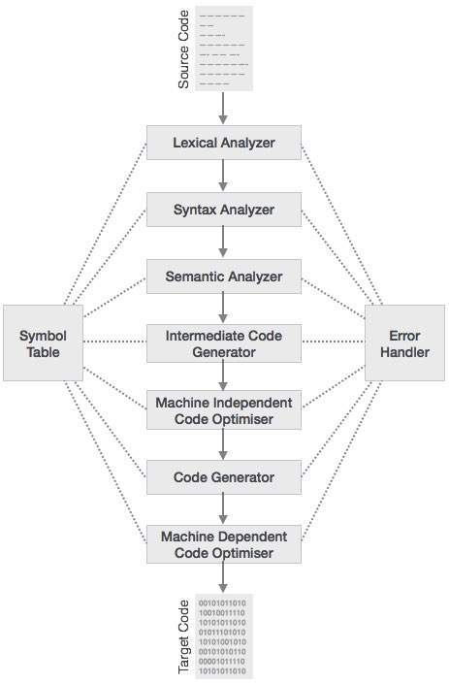
Phases of Compiler
The compilation process is a sequence of various phases. Each phase takes input from its previous stage, has its own representation of source program, and feeds its output to the next phase of the compiler. Let us understand the phases of a compiler.

Slide 12
Analysis Phase
An intermediate representation is created from the given source code :
Lexical Analyzer
Syntax Analyzer
Semantic Analyzer
Intermediate Code Generator
Synthesis Phase
An equivalent target program is created from the intermediate representation. It has two parts :
Code Optimizer
Code Generator
Introduction of Lexical Analysis
Lexical analysis, also known as scanning is the first phase of a compiler which involves reading the source program character by character from left to right and organizing them into tokens. Tokens are meaningful sequences of characters. There are usually only a small number of tokens for a programming language including constants (such as integers, doubles, characters, and strings), operators (arithmetic, relational, and logical), punctuation marks and reserved keywords.
Lexical Analysis
The lexical analyzer takes a source program as input, and produces a stream of tokens as output.

Slide 13
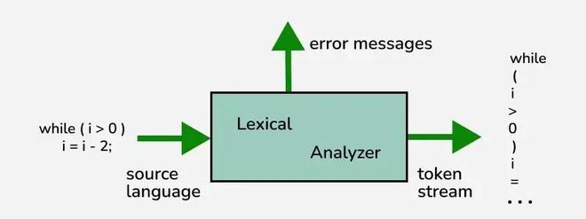
What is a Token?
A lexical token is a sequence of characters that can be treated as a unit in the grammar of the programming languages.
Categories of Tokens
Keywords: In C programming, keywords are reserved words with specific meanings used to define the language’s structure like if, else, for, and void. These cannot be used as variable names or identifiers, as doing so causes compilation errors. C programming has a total of 32 keywords.
Identifiers: Identifiers in C are names for variables, functions, arrays, or other user-defined items. They must start with a letter or an underscore (_) and can include letters, digits, and underscores. C is case-sensitive, so uppercase and lowercase letters are different. Identifiers cannot be the same as keywords like if, else or for.

Slide 14
Constants: Constants are fixed values that cannot change during a program’s execution, also known as literals. In C, constants include types like integers, floating-point numbers, characters, and strings.
Operators: Operators are symbols in C that perform actions on variables or other data items, called operands.
Special Symbols: Special symbols in C are compiler tokens used for specific purposes, such as separating code elements or defining operations. Examples include ; (semicolon) to end statements, , (comma) to separate values, {} (curly braces) for code blocks, and [] (square brackets) for arrays. These symbols play a crucial role in the program’s structure and syntax.
What is a Lexeme?
A lexeme is an actual string of characters that matches with a pattern and generates a token. eg- “float”, “abs_zero_Kelvin”, “=”, “-”, “273”, “;” .
Lexemes and Tokens Representation
Lexemes | Tokens | Lexemes Continued… | Tokens Continued…
while | WHILE | a | IDENTIEFIER
( | LAPREN | = | ASSIGNMENT
a | IDENTIFIER | a | IDENTIFIER
>= | COMPARISON | – | ARITHMETIC
b | IDENTIFIER | 2 | INTEGER
) | RPAREN | ; | SEMICOLON

Slide 15
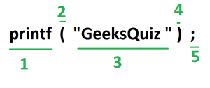
How Lexical Analyzer Works?
Tokens in a programming language can be described using regular expressions. A scanner, or lexical analyzer, uses a Deterministic Finite Automaton (DFA) to recognize these tokens, as DFAs are designed to identify regular languages. Each final state of the DFA corresponds to a specific token type, allowing the scanner to classify the input. The process of creating a DFA from regular expressions can be automated, making it easier to handle token recognition efficiently.
Read more about Working of Lexical Analyzer in Compiler.
The lexical analyzer identifies the error with the help of the automation machine and the grammar of the given language on which it is based like C, C++, and gives row number and column number of the error.
Suppose we pass a statement through lexical analyzer: a = b + c;
It will generate token sequence like this: id=id+id; Where each id refers to it’s variable in the symbol table referencing all details For example, consider the program
int main() { // 2 variables int a, b; a = 10; return 0; }
All the valid tokens are:
‘int’ ‘main’ ‘(‘ ‘)’ ‘{‘ ‘int’ ‘a’ ‘,’ ‘b’ ‘;’ ‘a’ ‘=’ ’10’ ‘;’ ‘return’ ‘0’ ‘;’ ‘}’
Above are the valid tokens. You can observe that we have omitted comments. As another example, consider below printf statement.

Slide 16
There are 5 valid token in this printf statement.
Exercise 1: Count number of tokens:
int main() { int a = 10, b = 20; printf(“sum is:%d”,a+b); return 0; } Answer: Total number of token: 27.
Advantages
Simplifies Parsing: Breaking down the source code into tokens makes it easier for computers to understand and work with the code. This helps programs like compilers or interpreters to figure out what the code is supposed to do. It’s like breaking down a big puzzle into smaller pieces, which makes it easier to put together and solve.
Error Detection: Lexical analysis will detect lexical errors such as misspelled keywords or undefined symbols early in the compilation process. This helps in improving the overall efficiency of the compiler or interpreter by identifying errors sooner rather than later.
Efficiency: Once the source code is converted into tokens, subsequent phases of compilation or interpretation can operate more efficiently. Parsing and semantic analysis become faster and more streamlined when working with tokenized input.

Slide 17
Disadvantages
Limited Context: Lexical analysis operates based on individual tokens and does not consider the overall context of the code. This can sometimes lead to ambiguity or misinterpretation of the code’s intended meaning especially in languages with complex syntax or semantics.
Overhead: Although lexical analysis is necessary for the compilation or interpretation process, it adds an extra layer of overhead. Tokenizing the source code requires additional computational resources which can impact the overall performance of the compiler or interpreter.
Debugging Challenges: Lexical errors detected during the analysis phase may not always provide clear indications of their origins in the original source code. Debugging such errors can be challenging especially if they result from subtle mistakes in the lexical analysis process.

Slide 18
Introduction to Syntax Analysis in Compiler Design
Last Updated : 28 Dec, 2024
Syntax analysis, often known as parsing, is an important step in the compilation process. Following lexical analysis (which divides the input into tokens), syntax analysis ensures that these tokens are arranged according to with the programming language’s grammar. This process helps in detecting and reporting errors, ensuring the source code adheres to the rules before further processing in the compiler.
What is Syntax Analysis?
Syntax analysis (parsing) is the second phase of the compilation process, following lexical analysis. Its primary goal is to verify the syntactical correctness of the source code. It takes the tokens generated by the lexical analyzer and attempts to build a Parse Tree or Abstract Syntax Tree (AST), representing the program’s structure. During this phase, the syntax analyzer checks whether the input string adheres to the grammatical rules of the language using context-free grammar. If the syntax is correct, the analyzer moves forward; otherwise, it reports an error.
The main goal of syntax analysis is to create a parse tree or abstract syntax tree (AST) of the source code, which is a hierarchical representation of the source code that reflects the grammatical structure of the program.

Slide 19
Parsing Algorithms Used in Syntax Analysis
LL parsing: This is a top-down parsing algorithm that starts with the root of the parse tree and constructs the tree by successively expanding non-terminals. LL parsing is known for its simplicity and ease of implementation.
LR parsing: This is a bottom-up parsing algorithm that starts with the leaves of the parse tree and constructs the tree by successively reducing terminals. LR parsing is more powerful than LL parsing and can handle a larger class of grammars.
LR(1) parsing: This is a variant of LR parsing that uses lookahead to disambiguate the grammar.
LALR parsing: This is a variant of LR parsing that uses a reduced set of lookahead symbols to reduce the number of states in the LR parser.
Once the parse tree is constructed, the compiler can perform semantic analysis to check if the source code makes sense and follows the semantics of the programming language.
The parse tree or AST can also be used in the code generation phase of the compiler design to generate intermediate code or machine code .

Slide 20
Features of Syntax Analysis
Syntax Trees: Syntax analysis creates a syntax tree, which is a hierarchical representation of the code’s structure. The tree shows the relationship between the various parts of the code, including statements, expressions, and operators.
Context-Free Grammar: Syntax analysis uses context-free grammar to define the syntax of the programming language. Context-free grammar is a formal language used to describe the structure of programming languages.
Top-Down and Bottom-Up Parsing: Syntax analysis can be performed using two main approaches: top-down parsing and bottom-up parsing. Top-down parsing starts from the highest level of the syntax tree and works its way down, while bottom-up parsing starts from the lowest level and works its way up.
Error Detection: Syntax analysis is responsible for detecting syntax errors in the code. If the code does not conform to the rules of the programming language, the parser will report an error and halt the compilation process.
Intermediate Code Generation: Syntax analysis generates an intermediate representation of the code, which is used by the subsequent phases of the compiler. The intermediate representation is usually a more abstract form of the code, which is easier to work with than the original source code.
Optimization: Syntax analysis can perform basic optimizations on the code, such as removing redundant code and simplifying expressions.

Slide 21
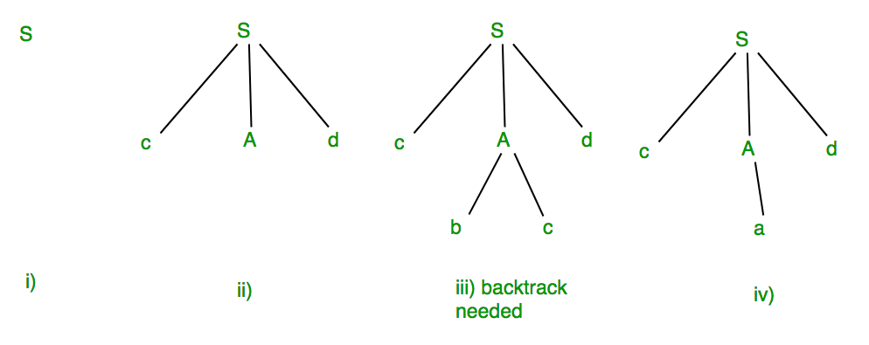
Example: Suppose Production rules for the Grammar of a language are:
S->cAd A->bc|a And the input string is “cad”.
Now the parser attempts to construct a syntax tree from this grammar for the given input string. It uses the given production rules and applies those as needed to generate the string. To generate string “cad” it uses the rules as shown in the given

Slide 22
In step (iii) above, the production rule A->bc was not a suitable one to apply (because the string produced is “cbcd” not “cad”), here the parser needs to backtrack, and apply the next production rule available with A which is shown in step (iv), and the string “cad” is produced.
Thus, the given input can be produced by the given grammar, therefore the input is correct in syntax. But backtrack was needed to get the correct syntax tree, which is really a complex process to implement.
There can be an easier way to solve this, which we shall see in the next article “Concepts of FIRST and FOLLOW sets in Compiler Design”.
Advantages
Advantages of using syntax analysis in compiler design include:
Structural validation: Syntax analysis allows the compiler to check if the source code follows the grammatical rules of the programming language, which helps to detect and report errors in the source code.
Improved code generation: Syntax analysis can generate a parse tree or abstract syntax tree (AST) of the source code, which can be used in the code generation phase of the compiler design to generate more efficient and optimized code.
Easier semantic analysis: Once the parse tree or AST is constructed, the compiler can perform semantic analysis more easily, as it can rely on the structural information provided by the parse tree or AST .

Slide 23
Disadvantages
Disadvantages of using syntax analysis in compiler design include:
Complexity: Parsing is a complex process, and the quality of the parser can greatly impact the performance of the resulting code. Implementing a parser for a complex programming language can be a challenging task, especially for languages with ambiguous grammars.
Reduced performance: Syntax analysis can add overhead to the compilation process, which can reduce the performance of the compiler.
Limited error recovery: Syntax analysis algorithms may not be able to recover from errors in the source code, which can lead to incomplete or incorrect parse trees and make it difficult for the compiler to continue the compilation process.
Inability to handle all languages: Not all languages have formal grammars, and some languages may not be easily parseable.
Overall, syntax analysis is an important stage in the compiler design process, but it should be balanced against the goals.

Slide 24
Steps in Syntax Analysis Phase
Tokenization: The input program is divided into a sequence of tokens, which are basic building blocks of the programming language, such as identifiers, keywords, operators, and literals.
Parsing: The tokens are analyzed according to the grammar rules of the programming language, and a parse tree or AST is constructed that represents the hierarchical structure of the program.
Error handling: If the input program contains syntax errors, the syntax analyzer detects and reports them to the user, along with an indication of where the error occurred.
Symbol table creation: The syntax analyzer creates a symbol table, which is a data structure that stores information about the identifiers used in the program, such as their type, scope, and location.
The syntax analysis phase is essential for the subsequent stages of the compiler, such as semantic analysis, code generation, and optimization. If the syntax analysis is not performed correctly, the compiler may generate incorrect code or fail to compile the program altogether.

Slide 25
Semantic Analysis in Compiler Design
Last Updated : 22 Apr, 2020
Semantic Analysis is the third phase of Compiler. Semantic Analysis makes sure that declarations and statements of program are semantically correct. It is a collection of procedures which is called by parser as and when required by grammar. Both syntax tree of previous phase and symbol table are used to check the consistency of the given code. Type checking is an important part of semantic analysis where compiler makes sure that each operator has matching operands.
Semantic Analyzer: It uses syntax tree and symbol table to check whether the given program is semantically consistent with language definition. It gathers type information and stores it in either syntax tree or symbol table. This type information is subsequently used by compiler during intermediate-code generation.
Semantic Errors: Errors recognized by semantic analyzer are as follows:
Type mismatch
Undeclared variables
Reserved identifier misuse

Slide 26
Functions of Semantic Analysis:
Type Checking – Ensures that data types are used in a way consistent with their definition.
Label Checking – A program should contain labels references.
Flow Control Check – Keeps a check that control structures are used in a proper manner.(example: no break statement outside a loop)
Example:
float x = 10.1; float y = x*30;
In the above example integer 30 will be typecasted to float 30.0 before multiplication, by semantic analyzer.
Static and Dynamic Semantics:
Static Semantics – It is named so because of the fact that these are checked at compile time. The static semantics and meaning of program during execution, are indirectly related.
Dynamic Semantic Analysis – It defines the meaning of different units of program like expressions and statements. These are checked at runtime unlike static semantics.

Slide 27
Intermediate Code Generation in Compiler Design
In the analysis-synthesis model of a compiler, the front end of a compiler translates a source program into an independent intermediate code, then the back end of the compiler uses this intermediate code to generate the target code (which can be understood by the machine). The benefits of using machine-independent intermediate code are:
Because of the machine-independent intermediate code, portability will be enhanced. For example, suppose, if a compiler translates the source language to its target machine language without having the option for generating intermediate code, then for each new machine, a full native compiler is required. Because, obviously, there were some modifications in the compiler itself according to the machine specifications.
Retargeting is facilitated.
It is easier to apply source code modification to improve the performance of source code by optimizing the intermediate code.
What is Intermediate Code Generation?
Intermediate Code Generation is a stage in the process of compiling a program, where the compiler translates the source code into an intermediate representation. This representation is not machine code but is simpler than the original high-level code. Here’s how it works:
Translation: The compiler takes the high-level code (like C or Java) and converts it into an intermediate form, which can be easier to analyze and manipulate.
Portability: This intermediate code can often run on different types of machines without needing major changes, making it more versatile.
Optimization: Before turning it into machine code, the compiler can optimize this intermediate code to make the final program run faster or use less memory.

Slide 28
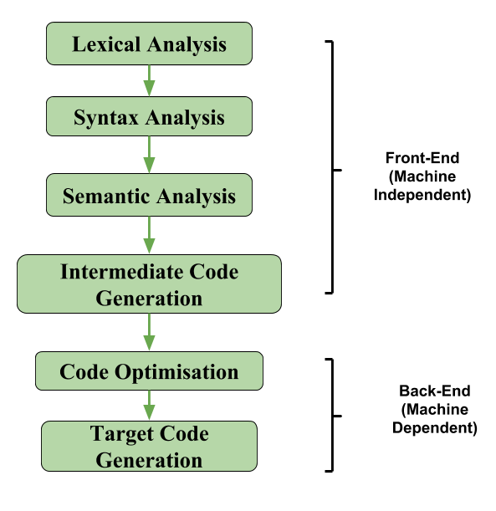

Slide 29
If we generate machine code directly from source code then for n target machine we will have optimizers and n code generator but if we will have a machine-independent intermediate code, we will have only one optimizer. Intermediate code can be either language-specific (e.g., Bytecode for Java) or language. independent (three-address code). The following are commonly used intermediate code representations:
Postfix Notation
Also known as reverse Polish notation or suffix notation.
In the infix notation, the operator is placed between operands, e.g., a + b. Postfix notation positions the operator at the right end, as in ab +.
For any postfix expressions e1 and e2 with a binary operator (+) , applying the operator yields e1e2+.
Postfix notation eliminates the need for parentheses, as the operator’s position and arity allow unambiguous expression decoding.
In postfix notation, the operator consistently follows the operand.
Example 1: The postfix representation of the expression (a + b) * c is : ab + c * Example 2: The postfix representation of the expression (a – b) * (c + d) + (a – b) is : ab – cd + *ab -+

Slide 30
Three-Address Code
A three address statement involves a maximum of three references, consisting of two for operands and one for the result.
A sequence of three address statements collectively forms a three address code.
The typical form of a three address statement is expressed as x = y op z, where x, y, and z represent memory addresses.
Each variable (x, y, z) in a three address statement is associated with a specific memory location.
While a standard three address statement includes three references, there are instances where a statement may contain fewer than three references, yet it is still categorized as a three address statement. Example: The three address code for the expression a + b * c + d : T1 = b * c T2 = a + T1 T3 = T2 + d; T 1 , T2 , T3 are temporary variables.
There are 3 ways to represent a Three-Address Code in compiler design: i) Quadruples ii) Triples iii) Indirect Triples Read more: Three-address code

Slide 31
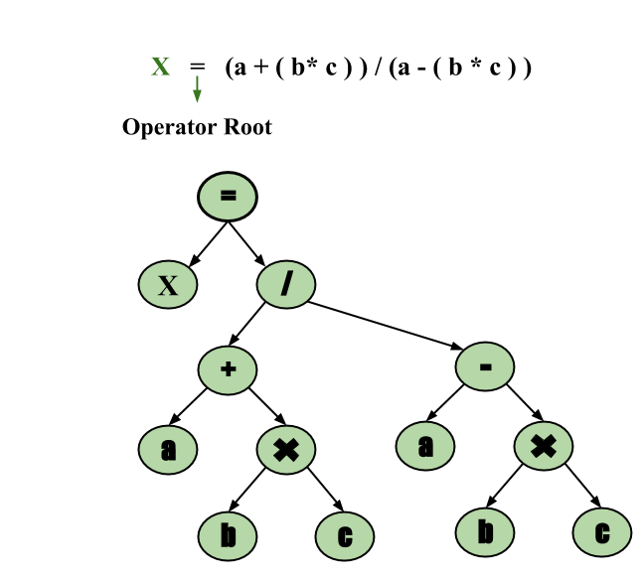
Syntax Tree
A syntax tree serves as a condensed representation of a parse tree.
The operator and keyword nodes present in the parse tree undergo a relocation process to become part of their respective parent nodes in the syntax tree. the internal nodes are operators and child nodes are operands.
Creating a syntax tree involves strategically placing parentheses within the expression. This technique contributes to a more intuitive representation, making it easier to discern the sequence in which operands should be processed.
The syntax tree not only condenses the parse tree but also offers an improved visual representation of the program’s syntactic structure, Example: x = (a + b * c) / (a – b * c)

Slide 32
Advantages of Intermediate Code Generation
Easier to Implement: Intermediate code generation can simplify the code generation process by reducing the complexity of the input code, making it easier to implement.
Facilitates Code Optimization: Intermediate code generation can enable the use of various code optimization techniques, leading to improved performance and efficiency of the generated code.
Platform Independence: Intermediate code is platform-independent, meaning that it can be translated into machine code or bytecode for any platform.
Code Reuse: Intermediate code can be reused in the future to generate code for other platforms or languages.
Easier Debugging: Intermediate code can be easier to debug than machine code or bytecode, as it is closer to the original source code.
Disadvantages of Intermediate Code Generation
Increased Compilation Time: Intermediate code generation can significantly increase the compilation time, making it less suitable for real-time or time-critical applications.
Additional Memory Usage: Intermediate code generation requires additional memory to store the intermediate representation, which can be a concern for memory-limited systems.
Increased Complexity: Intermediate code generation can increase the complexity of the compiler design, making it harder to implement and maintain.
Reduced Performance: The process of generating intermediate code can result in code that executes slower than code generated directly from the source code.

Slide 33
Code Optimization in Compiler Design
Last Updated : 04 Sep, 2024
Code optimization is a crucial phase in compiler design aimed at enhancing the performance and efficiency of the executable code. By improving the quality of the generated machine code optimizations can reduce execution time, minimize resource usage, and improve overall system performance. This process involves the various techniques and strategies applied during compilation to produce more efficient code without altering the program’s functionality.
The code optimization in the synthesis phase is a program transformation technique, which tries to improve the intermediate code by making it consume fewer resources (i.e. CPU, Memory) so that faster-running machine code will result. The compiler optimizing process should meet the following objectives:
The optimization must be correct, it must not, in any way, change the meaning of the program.
Optimization should increase the speed and performance of the program.
The compilation time must be kept reasonable.
The optimization process should not delay the overall compiling process.
When to Optimize?
Optimization of the code is often performed at the end of the development stage since it reduces readability and adds code that is used to increase performance.

Slide 34
Why Optimize?
Optimizing an algorithm is beyond the scope of the code optimization phase. So the program is optimized. And it may involve reducing the size of the code. So, optimization helps to:
Reduce the space consumed and increases the speed of compilation.
Manually analyzing datasets involves a lot of time. Hence, we make use of software like Tableau for data analysis. Similarly, manually performing the optimization is also tedious and is better done using a code optimizer.
An optimized code often promotes re-usability.
Types of Code Optimization
The optimization process can be broadly classified into two types:
Machine Independent Optimization: This code optimization phase attempts to improve the intermediate code to get a better target code as the output. The part of the intermediate code which is transformed here does not involve any CPU registers or absolute memory locations.
Machine Dependent Optimization: Machine-dependent optimization is done after the target code has been generated and when the code is transformed according to the target machine architecture. It involves CPU registers and may have absolute memory references rather than relative references. Machine-dependent optimizers put efforts to take maximum advantage of the memory hierarchy.

Slide 35
Ways to Optimize Code
There are several ways to optimize code. Some of them are mentioned below.
Compile Time Evaluation:
(i) A = 2*(22.0/7.0)*r
Perform 2*(22.0/7.0)*r at compile time.
(ii) x = 12.4
y = x/2.3
Evaluate x/2.3 as 12.4/2.3 at compile time.
2. Variable Propagation:
//Before Optimization
c = a * b
x = a
till
d = x * b + 4
//After Optimization
c = a * b
x = a
till
d = a * b + 4

Slide 36
3. Constant Propagation:
If the value of a variable is a constant, then replace the variable with the constant. The variable may not always be a constant.
Example:
A = 2*(22.0/7.0)*r Performs 2*(22.0/7.0)*r at compile time.
(ii) x = 12.4 y = x/2.3 Evaluates x/2.3 as 12.4/2.3 at compile time.
(iii) int k=2; if(k) go to L3; It is evaluated as : go to L3 ( Because k = 2 which implies condition is always
)
4. Constant Folding:
Consider an expression : a = b op c and the values b and c are constants, then the value of a can be computed at compile time.
#define k 5
x = 2 * k
y = k + 5
This can be computed at compile time and the values of x and y are :
x = 10
y = 10
5. Copy Propagation:
It is extension of constant propagation.
After a is assigned to x, use a to replace x till a is assigned again to another variable or value or expression.
It helps in reducing the compile time as it reduces copying.

Slide 37
//Before Optimization c = a * b x = a till d = x * b + 4
//After Optimization d = a * b + 4
6. Common Sub Expression Elimination:
In the above example, a*b and x*b is a common sub expression.
7. Dead Code Elimination:
Copy propagation often leads to making assignment statements into dead code.
A variable is said to be dead if it is never used after its last definition.
In order to find the dead variables, a data flow analysis should be done.
8. Unreachable Code Elimination:
First, Control Flow Graph should be constructed.
The block which does not have an incoming edge is an Unreachable code block.
After constant propagation and constant folding, the unreachable branches can be eliminated.
9. Function Inlining:
Here, a function call is replaced by the body of the function itself.
This saves a lot of time in copying all the parameters, storing the return address, etc.
10. Function Cloning:
Here, specialized codes for a function are created for different calling parameters.
Example: Function Overloading
11. Induction Variable and Strength Reduction:
An induction variable is used in the loop for the following kind of assignment i = i + constant. It is a kind of Loop Optimization Technique.
Strength reduction means replacing the high strength operator with a low strength.

Slide 38
Loop Optimization Techniques
1. Code Motion or Frequency Reduction:
The evaluation frequency of expression is reduced.
The loop invariant statements are brought out of the loop.
a = 200;
while(a&gt;0)
{ b = x + y;
if (a % b == 0)
printf(“%d”, a);
}
//This code can be further optimized as
a = 200; b = x + y;
while(a&gt;0)
{ if (a % b == 0}
printf(“%d”, a);
}

Slide 39
2. Loop Jamming
Two or more loops are combined in a single loop. It helps in reducing the compile time.
// Before loop jamming
for(int k=0;k<10;k++)
{
x = k*2;
}
for(int k=0;k<10;k++)
{
y = k+3;
}
//After loop jamming
for(int k=0;k<10;k++)
{
x = k*2;
y = k+3;
}

Slide 40
3. Loop Unrolling
It helps in optimizing the execution time of the program by reducing the iterations.
It increases the program’s speed by eliminating the loop control and test instructions.
//Before Loop Unrolling
for(int i=0;i<2;i++)
{ printf("Hello"); } //After Loop Unrolling
printf("Hello");
printf("Hello");
Where to Apply Optimization?
Now that we learned the need for optimization and its two types,now let’s see where to apply these optimization.
Source program: Optimizing the source program involves making changes to the algorithm or changing the loop structures. The user is the actor here.
Intermediate Code: Optimizing the intermediate code involves changing the address calculations and transforming the procedure calls involved. Here compiler is the actor.
Target Code: Optimizing the target code is done by the compiler. Usage of registers, and select and move instructions are part of the optimization involved in the target code.
Local Optimization: Transformations are applied to small basic blocks of statements. Techniques followed are Local Value Numbering and Tree Height Balancing.
Regional Optimization: Transformations are applied to Extended Basic Blocks. Techniques followed are Super Local Value Numbering and Loop Unrolling.
Global Optimization: Transformations are applied to large program segments that include functions, procedures, and loops. Techniques followed are Live Variable Analysis and Global Code Replacement.
Interprocedural Optimization: As the name indicates, the optimizations are applied inter procedurally. Techniques followed are Inline Substitution and Procedure Placement.

Slide 41
Advantages of Code Optimization
Improved performance: Code optimization can result in code that executes faster and uses fewer resources, leading to improved performance.
Reduction in code size: Code optimization can help reduce the size of the generated code, making it easier to distribute and deploy.
Increased portability: Code optimization can result in code that is more portable across different platforms, making it easier to target a wider range of hardware and software.
Reduced power consumption: Code optimization can lead to code that consumes less power, making it more energy-efficient.
Improved maintainability: Code optimization can result in code that is easier to understand and maintain, reducing the cost of software maintenance.
Disadvantages of Code Optimization
Increased compilation time: Code optimization can significantly increase the compilation time, which can be a significant drawback when developing large software systems.
Increased complexity: Code optimization can result in more complex code, making it harder to understand and debug.
Potential for introducing bugs: Code optimization can introduce bugs into the code if not done carefully, leading to unexpected behavior and errors.
Difficulty in assessing the effectiveness: It can be difficult to determine the effectiveness of code optimization, making it hard to justify the time and resources spent on the process.

Slide 42
Simple Code Generator
Last Updated : 18 Nov, 2022
Compiler Design is an important component of compiler construction. It involves many different tasks, such as analyzing the source code and producing an intermediate representation (IR) from it, performing optimizations on the IR to produce a target machine code, and generating external representations (ORs) for programs used in debugging or testing. In this paper, we describe our efforts to improve the design of simple language generators. We introduce a new reusable component called “Simple Code Generator” (SCG), which implements several functions that make it easy to create simple code generators for any programming language. The SCG component consists of two parts: firstly it contains a parser that transforms textual inputs into an abstract syntax tree; secondly, its generated AST has expressions in a symbolic form wherever possible instead of merely representing them as strings like most other compilers do today.
A code generator is a compiler that translates the intermediate representation of the source program into the target program. In other words, a code generator translates an abstract syntax tree into machine-dependent executable code. The process of generating machine-dependent output from an abstract syntax tree involves two steps: one for constructing the abstract syntax tree and another for generating its corresponding machine code.
The first step involves constructing an Abstract Syntax Tree (AST) by traversing all possible paths through your input file(s). This tree will contain information about every bit of data in your program as they are encountered during parsing or execution time; it’s important to note that this can take place both at compile time (as part of compiling) or runtime (in some cases).

Slide 43
Register Descriptor
Register descriptors are data structures that store information about the registers used in the program. This includes the registration number and its name, along with its type. The compiler uses this information when generating machine code for your program, so it’s important to keep it up-to-date while writing code!
The compiler uses the register file to determine what values will be available for use in your program. This is done by walking through each of the registers and determining if they contain valid data or not. If there’s nothing in a register, then it can be used for other purposes!
Address Descriptor
An address descriptor is used to represent the memory locations used by a program. Address descriptors are created by the getReg function, which returns a structure containing information about how to access memory. Address descriptors can be created for any instruction in your program’s code and stored in registers or on the stack; however, only one instance of an address descriptor will exist at any given time (unless another thread is executing).
When the user wants to retrieve data from an arbitrary location within the program’s source code using getReg, call this method with two arguments: The first argument specifies which register contains your desired value (e.g., ‘M’), while the second argument specifies where exactly within this register should it be placed back onto its original storage location on disk/memory before returning it back up into main memory again after successfully accessing its contents via indirect calls like LoadFromBuffer() or StoreToBuffer().

Slide 44
Code Generation Algorithm
The code generation algorithm is the core of the compiler. It sets up register and address descriptors, then generates machine instructions that give you CPU-level control over your program.
The algorithm is split into four parts: register descriptor set-up, basic block generation, instruction generation for operations on registers (e.g., addition), and ending the basic block with a jump statement or return command.
Register Descriptor Set Up: This part sets up an individual register’s value in memory space by taking its index into an array of all possible values for that type of register (i32). It also stores information about what kind of operation was performed on it so that subsequent steps can identify which operation happened if they’re called multiple times during execution.
Basic Block Generation: This step involves creating individual blocks within each basic block as well as lines between them so we can keep track of where things are happening at any given moment during execution.
Instruction Generation For Operations On Registers: This step converts source code statements into machine instructions using information from both our ELF file format files (the ones generated by GCC) as well as other sources such as Bazel’s build system which knows how to generate particular kind of machine code for particular CPUs. This is where we start to see the magic of how compilers work in practice, as they’re able to generate code that’s optimized in various ways based on the type of operation being performed (e.g., addition) and the registers involved (i32).

Slide 45
Compiler Construction Tools
Compiler construction tools are specialized software that help developers create compilers more efficiently. Here are the key tools:
Parser Generators: It creates syntax analyzers (parsers) based on grammatical descriptions of programming languages.
Scanner Generators: It produces lexical analyzers using regular expressions to define the tokens of a language.
Syntax-Directed Translation Engines: It generates intermediate code in three-address format from input comprising a parse tree.
Automatic Code Generators: It converts intermediate language into machine language using template matching techniques.
Data-Flow Analysis Engines: It supports code optimization by analyzing the flow of values throughout different parts of the program.
Compiler Construction Toolkits: It provides integrated routines to facilitate the construction of various compiler components.

Slide 46
Types of Compiler
Self Compiler: When the compiler runs on the same machine and produces machine code for the same machine on which it is running then it is called as self compiler or resident compiler.
Cross Compiler: The compiler may run on one machine and produce the machine codes for other computers then in that case it is called a cross-compiler. It is capable of creating code for a platform other than the one on which the compiler is running.
Source-to-Source Compiler: A Source-to-Source Compiler or transcompiler or transpiler is a compiler that translates source code written in one programming language into the source code of another programming language.
Single Pass Compiler: When all the phases of the compiler are present inside a single module, it is simply called a single-pass compiler. It performs the work of converting source code to machine code.
Two Pass Compiler: Two-pass compiler is a compiler in which the program is translated twice, once from the front end and the back from the back end known as Two Pass Compiler.
Multi-Pass Compiler: When several intermediate codes are created in a program and a syntax tree is processed many times, it is called Multi-Pass Compiler. It breaks codes into smaller programs.
Just-in-Time (JIT) Compiler: It is a type of compiler that converts code into machine language during program execution, rather than before it runs. It combines the benefits of interpretation (real-time execution) and traditional compilation (faster execution).
Ahead-of-Time (AOT) Compiler: It converts the entire source code into machine code before the program runs. This means the code is fully compiled during development, resulting in faster startup times and better performance at runtime.
Incremental Compiler: It compiles only the parts of the code that have changed, rather than recompiling the entire program. This makes the compilation process faster and more efficient, especially during development.

Slide 47
Operations of Compiler
These are some operations that are done by the compiler.
It breaks source programs into smaller parts.
It enables the creation of symbol tables and intermediate representations.
It helps in code compilation and error detection.
it saves all codes and variables.
It analyses the full program and translates it.
Convert source code to machine code.
Advantages of Compiler Design
Efficiency: Compiled programs are generally more efficient than interpreted programs because the machine code produced by the compiler is optimized for the specific hardware platform on which it will run.
Portability: Once a program is compiled, the resulting machine code can be run on any computer or device that has the appropriate hardware and operating system, making it highly portable.
Error Checking: Compilers perform comprehensive error checking during the compilation process, which can help catch syntax, semantic, and logical errors in the code before it is run.
Optimizations: Compilers can make various optimizations to the generated machine code, such as eliminating redundant instructions or rearranging code for better performance.
Disadvantages of Compiler Design
Longer Development Time: Developing a compiler is a complex and time-consuming process that requires a deep understanding of both the programming language and the target hardware platform.
Debugging Difficulties: Debugging compiled code can be more difficult than debugging interpreted code because the generated machine code may not be easy to read or understand.
Lack of Interactivity: Compiled programs are typically less interactive than interpreted programs because they must be compiled before they can be run, which can slow down the development and testing process.
Platform-Specific Code: If the compiler is designed to generate machine code for a specific hardware platform, the resulting code may not be portable to other platforms.

Slide 48
Error detection and Recovery in Compiler
Last Updated : 20 Apr, 2023
In this phase of compilation, all possible errors made by the user are detected and reported to the user in form of error messages. This process of locating errors and reporting them to users is called the Error Handling process.
Functions of an Error handler.
Detection
Reporting
Recovery
Classification of Errors

Slide 49
Compile-time errors
Compile-time errors are of three types:-
Lexical phase errors
These errors are detected during the lexical analysis phase. Typical lexical errors are:
Exceeding length of identifier or numeric constants.
The appearance of illegal characters
Unmatched string
Example 1 : printf("Geeksforgeeks");
$ This is a lexical error since an illegal character $ appears at the end of statement.
Example 2 : This is a comment */
This is an lexical error since end of comment is present but beginning is not present
Error recovery for lexical errors:
Panic Mode Recovery
In this method, successive characters from the input are removed one at a time until a designated set of synchronizing tokens is found. Synchronizing tokens are delimiters such as; or }
The advantage is that it is easy to implement and guarantees not to go into an infinite loop
The disadvantage is that a considerable amount of input is skipped without checking it for additional errors

Slide 50
Syntactic phase errors:
These errors are detected during the syntax analysis phase. Typical syntax errors are:
Errors in structure
Missing operator
Misspelled keywords
Unbalanced parenthesis
Example : swich(ch)
{ .......
.......
}
The keyword switch is incorrectly written as a swich. Hence, an “Unidentified keyword/identifier” error occurs.
Error recovery for syntactic phase error:
1. Panic Mode Recovery
In this method, successive characters from the input are removed one at a time until a designated set of synchronizing tokens is found. Synchronizing tokens are deli-meters such as; or }
The advantage is that it’s easy to implement and guarantees not to go into an infinite loop
The disadvantage is that a considerable amount of input is skipped without checking it for additional errors

Slide 51
2. Statement Mode recovery
In this method, when a parser encounters an error, it performs the necessary correction on the remaining input so that the rest of the input statement allows the parser to parse ahead.
The correction can be deletion of extra semicolons, replacing the comma with semicolons, or inserting a missing semicolon.
While performing correction, utmost care should be taken for not going in an infinite loop.
A disadvantage is that it finds it difficult to handle situations where the actual error occurred before pointing of detection.
3. Error production
If a user has knowledge of common errors that can be encountered then, these errors can be incorporated by augmenting the grammar with error productions that generate erroneous constructs.
If this is used then, during parsing appropriate error messages can be generated and parsing can be continued.
The disadvantage is that it’s difficult to maintain.
4. Global Correction
The parser examines the whole program and tries to find out the closest match for it which is error-free.
The closest match program has less number of insertions, deletions, and changes of tokens to recover from erroneous input.
Due to high time and space complexity, this method is not implemented practically.

Slide 52
Semantic errors
These errors are detected during the semantic analysis phase. Typical semantic errors are
Incompatible type of operands
Undeclared variables
Not matching of actual arguments with a formal one
Example : int a[10], b;
.......
.......
a = b;
It generates a semantic error because of an incompatible type of a and b.
Error recovery for Semantic errors
If the error “Undeclared Identifier” is encountered then, to recover from this a symbol table entry for the corresponding identifier is made.
If data types of two operands are incompatible then, automatic type conversion is done by the compiler.

Slide 53
Advantages:
Improved code quality: Error detection and recovery in a compiler can improve the overall quality of the code produced. This is because errors can be identified early in the compilation process and addressed before they become bigger issues.
Increased productivity: Error recovery can also increase productivity by allowing the compiler to continue processing the code after an error is detected. This means that developers do not have to stop and fix every error manually, saving time and effort.
Better user experience: Error recovery can also improve the user experience of software applications. When errors are handled gracefully, users are less likely to become frustrated and are more likely to continue using the application.
Better debugging: Error recovery in a compiler can help developers to identify and debug errors more efficiently. By providing detailed error messages, the compiler can assist developers in pinpointing the source of the error, saving time and effort.
Consistent error handling: Error recovery ensures that all errors are handled in a consistent manner, which can help to maintain the quality and reliability of the software being developed.
Reduced maintenance costs: By detecting and addressing errors early in the development process, error recovery can help to reduce maintenance costs associated with fixing errors in later stages of the software development lifecycle.
Improved software performance: Error recovery can help to identify and address code that may cause performance issues, such as memory leaks or inefficient algorithms. By improving the performance of the code, the overall performance of the software can be improved as well.

Slide 54
Disadvantages:
Slower compilation time: Error detection and recovery can slow down the compilation process, especially if the recovery mechanism is complex. This can be an issue in large software projects where the compilation time can be a bottleneck.
Increased complexity: Error recovery can also increase the complexity of the compiler, making it harder to maintain and debug. This can lead to additional development costs and longer development times.
Risk of silent errors: Error recovery can sometimes mask errors in the code, leading to silent errors that go unnoticed. This can be particularly problematic if the error affects the behavior of the software application in subtle ways.
Potential for incorrect recovery: If the error recovery mechanism is not implemented correctly, it can potentially introduce new errors or cause the code to behave unexpectedly.
Dependency on the recovery mechanism: If developers rely too heavily on the error recovery mechanism, they may become complacent and not thoroughly check their code for errors. This can lead to errors being missed or not addressed properly.
Difficulty in diagnosing errors: Error recovery can make it more difficult to diagnose and debug errors since the error message may not accurately reflect the root cause of the issue. This can make it harder to fix errors and may lead to longer development times.
Compatibility issues: Error recovery mechanisms may not be compatible with certain programming languages or platforms, leading to issues with portability and cross-platform development.

Slide 55
Error Handling in Compiler Design
Last Updated : 14 Jul, 2023
The tasks of the Error Handling process are to detect each error, report it to the user, and then make some recovery strategy and implement them to handle the error. During this whole process processing time of the program should not be slow.
Functions of Error Handler:
Error Detection
Error Report
Error Recovery
Error handler=Error Detection+Error Report+Error Recovery.
An Error is the blank entries in the symbol table.
Errors in the program should be detected and reported by the parser. Whenever an error occurs, the parser can handle it and continue to parse the rest of the input. Although the parser is mostly responsible for checking for errors, errors may occur at various stages of the compilation process.

Slide 56
So, there are many types of errors and some of these are: Types or Sources of Error – There are three types of error: logic, run-time and compile-time error: Logic errors occur when programs operate incorrectly but do not terminate abnormally (or crash). Unexpected or undesired outputs or other behaviour may result from a logic error, even if it is not immediately recognized as such.
A run-time error is an error that takes place during the execution of a program and usually happens because of adverse system parameters or invalid input data. The lack of sufficient memory to run an application or a memory conflict with another program and logical error is an example of this. Logic errors occur when executed code does not produce the expected result. Logic errors are best handled by meticulous program debugging.
Compile-time errors rise at compile-time, before the execution of the program. Syntax error or missing file reference that prevents the program from successfully compiling is an example of this.

Slide 57
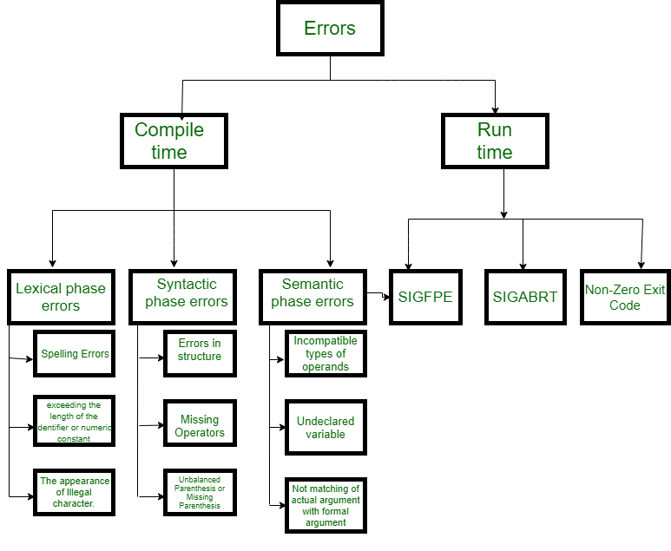

Slide 58
Classification of Compile-time error –
Lexical : This includes misspellings of identifiers, keywords or operators
Syntactical : a missing semicolon or unbalanced parenthesis
Semantical : incompatible value assignment or type mismatches between operator and operand
Logical : code not reachable, infinite loop.
Finding error or reporting an error – Viable-prefix is the property of a parser that allows early detection of syntax errors.
Goal detection of an error as soon as possible without further consuming unnecessary input
How: detect an error as soon as the prefix of the input does not match a prefix of any string in the language.
Example: for(;), this will report an error as for having two semicolons inside braces.
Error Recovery – The basic requirement for the compiler is to simply stop and issue a message, and cease compilation. There are some common recovery methods that are as follows.
We already discuss the errors. Now, let’s try to understand the recovery of errors in every phase of the compiler.

Slide 59
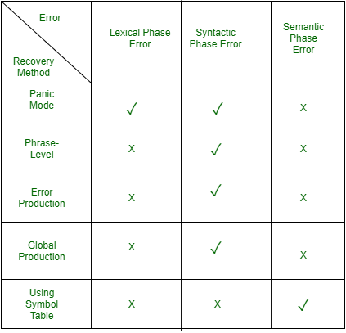

Slide 60
Panic mode recovery : This is the easiest way of error-recovery and also, it prevents the parser from developing infinite loops while recovering error. The parser discards the input symbol one at a time until one of the designated (like end, semicolon) set of synchronizing tokens (are typically the statement or expression terminators) is found. This is adequate when the presence of multiple errors in the same statement is rare. Example: Consider the erroneous expression- (1 + + 2) + 3.
Panic-mode recovery: Skip ahead to the next integer and then continue. Bison: use the special terminal error to describe how much input to skip.
E->int|E+E|(E)|error int|(error)
2. Phase level recovery : When an error is discovered, the parser performs local correction on the remaining input. If a parser encounters an error, it makes the necessary corrections on the remaining input so that the parser can continue to parse the rest of the statement. You can correct the error by deleting extra semicolons, replacing commas with semicolons, or reintroducing missing semicolons. To prevent going in an infinite loop during the correction, utmost care should be taken. Whenever any prefix is found in the remaining input, it is replaced with some string. In this way, the parser can continue to operate on its execution.
3. Error productions : The use of the error production method can be incorporated if the user is aware of common mistakes that are encountered in grammar in conjunction with errors that produce erroneous constructs. When this is used, error messages can be generated during the parsing process, and the parsing can continue. Example: write 5x instead of 5*x 4. Global correction : In order to recover from erroneous input, the parser analyzes the whole program and tries to find the closest match for it, which is error-free. The closest match is one that does not do many insertions, deletions, and changes of tokens. This method is not practical due to its high time and space complexity.

Slide 61
Advantages of Error Handling in Compiler Design:
1.Robustness: Mistake dealing with improves the strength of the compiler by permitting it to deal with and recuperate from different sorts of blunders smoothly. This guarantees that even within the sight of blunders, the compiler can keep handling the information program and give significant mistake messages.
2.Error location: By consolidating blunder taking care of components, a compiler can distinguish and recognize mistakes in the source code. This incorporates syntactic mistakes, semantic blunders, type blunders, and other potential issues that might make the program act startlingly or produce erroneous result.
3.Error revealing: Compiler mistake taking care of works with viable blunder answering to the client or software engineer. It creates engaging blunder messages that assist developers with understanding the nature and area of the mistake, empowering them to effectively fix the issues. Clear and exact mistake messages save designers significant time in the troubleshooting system.
4.Error recuperation: Mistake dealing with permits the compiler to recuperate from blunders and proceed with the aggregation cycle whenever the situation allows. This is accomplished through different methods like blunder adjustment, mistake synchronization, and resynchronization. The compiler endeavors to redress the blunders and continues with assemblage, keeping the whole interaction from being ended unexpectedly.
5.Incremental gathering: Mistake taking care of empowers gradual aggregation, where a compiler can order and execute right partitions of the program regardless of whether different segments contain blunders. This element is especially helpful for enormous scope projects, as it permits engineers to test and investigate explicit modules without recompiling the whole codebase.

Slide 62
Disadvantages of error handling in compiler design:
Increased complexity: Error handling in compiler design can significantly increase the complexity of the compiler. This can make the compiler more challenging to develop, test, and maintain. The more complex the error handling mechanism is, the more difficult it becomes to ensure that it is working correctly and to find and fix errors.
Reduced performance: Error handling in compiler design can also impact the performance of the compiler. This is especially true if the error handling mechanism is time-consuming and computationally intensive. As a result, the compiler may take longer to compile programs and may require more resources to operate.
Increased development time: Developing an effective error handling mechanism can be a time-consuming process. This is because it requires significant testing and debugging to ensure that it works as intended. This can slow down the development process and result in longer development times.
Difficulty in error detection: While error handling is designed to identify and handle errors in the source code, it can also make it more difficult to detect errors. This is because the error handling mechanism may mask some errors, making it harder to identify them. Additionally, if the error handling mechanism is not working correctly, it may fail to detect errors altogether.

Slide 64
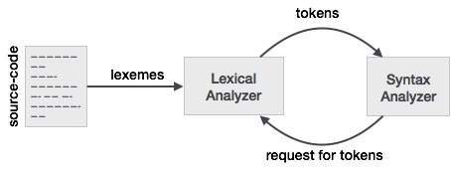
Compiler Design - Lexical Analysis
Lexical analysis is the first phase of a compiler. It takes the modified source code from language preprocessors that are written in the form of sentences. The lexical analyzer breaks these syntaxes into a series of tokens, by removing any whitespace or comments in the source code.
If the lexical analyzer finds a token invalid, it generates an error. The lexical analyzer works closely with the syntax analyzer. It reads character streams from the source code, checks for legal tokens, and passes the data to the syntax analyzer when it demands.

Slide 65
Tokens
Lexemes are said to be a sequence of characters (alphanumeric) in a token. There are some predefined rules for every lexeme to be identified as a valid token. These rules are defined by grammar rules, by means of a pattern. A pattern explains what can be a token, and these patterns are defined by means of regular expressions.
In programming language, keywords, constants, identifiers, strings, numbers, operators and punctuations symbols can be considered as tokens.
For example, in C language, the variable declaration line
int value = 100;
contains the tokens:
int (keyword), value (identifier), = (operator), 100 (constant) and ; (symbol).

Slide 66
Specifications of Tokens
Let us understand how the language theory undertakes the following terms:
Alphabets
Any finite set of symbols {0,1} is a set of binary alphabets, {0,1,2,3,4,5,6,7,8,9,A,B,C,D,E,F} is a set of Hexadecimal alphabets, {a-z, A-Z} is a set of English language alphabets.
Strings
Any finite sequence of alphabets (characters) is called a string. Length of the string is the total number of occurrence of alphabets, e.g., the length of the string tutorialspoint is 14 and is denoted by |tutorialspoint| = 14. A string having no alphabets, i.e. a string of zero length is known as an empty string and is denoted by ε (epsilon).
Special Symbols
A typical high-level language contains the following symbols:-
Arithmetic Symbols | Addition(+), Subtraction(-), Modulo(%), Multiplication(*), Division(/)
Punctuation | Comma(,), Semicolon(;), Dot(.), Arrow(->)
Assignment | =
Special Assignment | +=, /=, *=, -=
Comparison | ==, !=, <, <=, >, >=
Preprocessor | #
Location Specifier | &
Logical | &, &&, |, ||, !
Shift Operator | >>, >>>, <<, <<<

Slide 67
Language
A language is considered as a finite set of strings over some finite set of alphabets. Computer languages are considered as finite sets, and mathematically set operations can be performed on them. Finite languages can be described by means of regular expressions.
Regular Expressions
The lexical analyzer needs to scan and identify only a finite set of valid string/token/lexeme that belong to the language in hand. It searches for the pattern defined by the language rules.
Regular expressions have the capability to express finite languages by defining a pattern for finite strings of symbols. The grammar defined by regular expressions is known as regular grammar. The language defined by regular grammar is known as regular language.
Regular expression is an important notation for specifying patterns. Each pattern matches a set of strings, so regular expressions serve as names for a set of strings. Programming language tokens can be described by regular languages. The specification of regular expressions is an example of a recursive definition. Regular languages are easy to understand and have efficient implementation.
There are a number of algebraic laws that are obeyed by regular expressions, which can be used to manipulate regular expressions into equivalent forms.

Slide 68
Operations
The various operations on languages are:
Union of two languages L and M is written as
L U M = {s | s is in L or s is in M}
Concatenation of two languages L and M is written as
LM = {st | s is in L and t is in M}
The Kleene Closure of a language L is written as
L* = Zero or more occurrence of language L.
Notations
If r and s are regular expressions denoting the languages L(r) and L(s), then
Union : (r)|(s) is a regular expression denoting L(r) U L(s)
Concatenation : (r)(s) is a regular expression denoting L(r)L(s)
Kleene closure : (r)* is a regular expression denoting (L(r))*
(r) is a regular expression denoting L(r)
Precedence and Associativity
*, concatenation (.), and | (pipe sign) are left associative
* has the highest precedence
Concatenation (.) has the second highest precedence.
| (pipe sign) has the lowest precedence of all.

Slide 69
Representing valid tokens of a language in regular expression
If x is a regular expression, then:
x* means zero or more occurrence of x.
i.e., it can generate { e, x, xx, xxx, xxxx, … }
-:x+ means one or more occurrence of x.
i.e., it can generate { x, xx, xxx, xxxx … } or x.x*
-:x? means at most one occurrence of x
i.e., it can generate either {x} or {e}.
[a-z] is all lower-case alphabets of English language.
[A-Z] is all upper-case alphabets of English language.
[0-9] is all natural digits used in mathematics.
Representing occurrence of symbols using regular expressions
letter = [a – z] or [A – Z]
digit = 0 | 1 | 2 | 3 | 4 | 5 | 6 | 7 | 8 | 9 or [0-9]
sign = [ + | - ]
Representing language tokens using regular expressions
Decimal = (sign)?(digit)⁺
Identifier = (letter)(letter | digit)*
The only problem left with the lexical analyzer is how to verify the validity of a regular expression used in specifying the patterns of keywords of a language. A well-accepted solution is to use finite automata for verification.

Slide 70
Finite Automata
Finite automata is a state machine that takes a string of symbols as input and changes its state accordingly. Finite automata is a recognizer for regular expressions. When a regular expression string is fed into finite automata, it changes its state for each literal. If the input string is successfully processed and the automata reaches its final state, it is accepted, i.e., the string just fed was said to be a valid token of the language in hand.
The mathematical model of finite automata consists of:
Finite set of states (Q)
Finite set of input symbols (Σ)
One Start state (q0)
Set of final states (qf)
Transition function (δ)
The transition function (δ) maps the finite set of state (Q) to a finite set of input symbols (Σ), Q × Σ ➔ Q
Finite Automata Construction
Let L(r) be a regular language recognized by some finite automata (FA).

Slide 71
States : States of FA are represented by circles. State names are written inside circles.
Start state : The state from where the automata starts, is known as the start state. Start state has an arrow pointed towards it.
Intermediate states : All intermediate states have at least two arrows; one pointing to and another pointing out from them.
Final state : If the input string is successfully parsed, the automata is expected to be in this state. Final state is represented by double circles. It may have any odd number of arrows pointing to it and even number of arrows pointing out from it. The number of odd arrows are one greater than even, i.e. odd = even+1.
Transition : The transition from one state to another state happens when a desired symbol in the input is found. Upon transition, automata can either move to the next state or stay in the same state. Movement from one state to another is shown as a directed arrow, where the arrows points to the destination state. If automata stays on the same state, an arrow pointing from a state to itself is drawn.

Slide 72
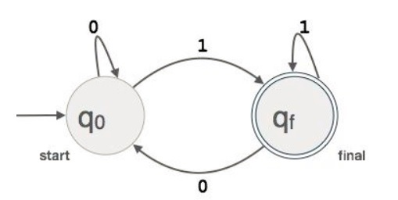
Example : We assume FA accepts any three digit binary value ending in digit 1. FA = {Q(q₀, q_{f}), Σ(0,1), q₀, q_{f}, δ}

Slide 73
Longest Match Rule
When the lexical analyzer read the source-code, it scans the code letter by letter; and when it encounters a whitespace, operator symbol, or special symbols, it decides that a word is completed.
For example:
int intvalue;
While scanning both lexemes till ‘int’, the lexical analyzer cannot determine whether it is a keyword int or the initials of identifier int value.
The Longest Match Rule states that the lexeme scanned should be determined based on the longest match among all the tokens available.
The lexical analyzer also follows rule priority where a reserved word, e.g., a keyword, of a language is given priority over user input. That is, if the lexical analyzer finds a lexeme that matches with any existing reserved word, it should generate an error.

